Slide 1




Enhancing relational models with graph processing In SQL Server 2017 Terry McCann @SQLshark
Notes:
About me.
Advanced Analytics Consultant for Adatis Consulting Limited in the UK
We specialise in Analytics for the Microsoft platform.
I also run the Exeter data science user group.

Slide 2
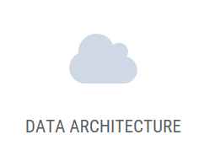


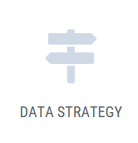
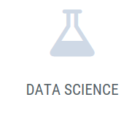
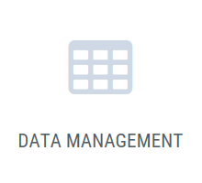
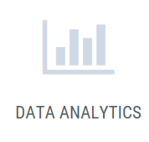
We enable our clients make sense of their data

Slide 3


Shout it out!!
Notes:
• How to Use the WHERE Clause
• Overview of Operators
• Filter Data by Using Comparison Operators
• Filter Data by Using String Comparisons
• Filter Data by Using Logical Operators
• Filter Data Using a Range of Values
• Filter Data Using a List of Values
• Working with NULL Values
• Introducing Native SQL Server Functions
• Functions Relating to NULL Values

Slide 4
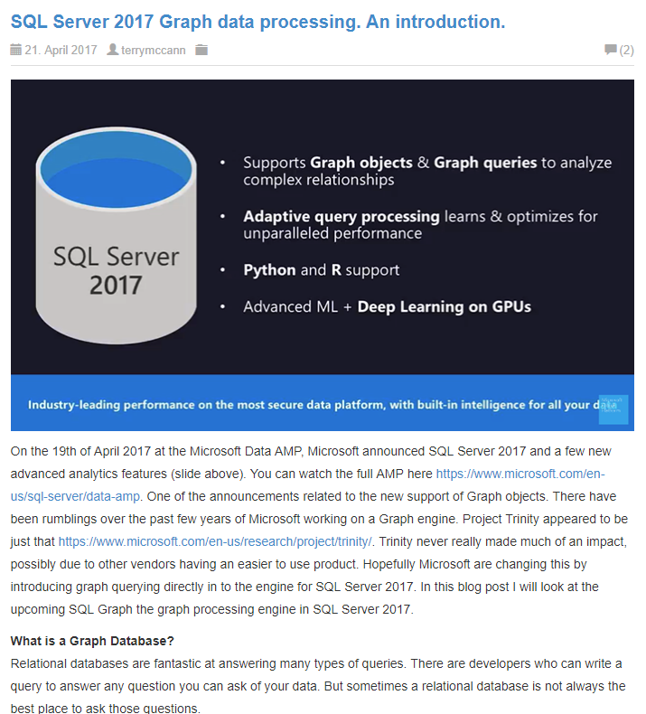
Where to find the slides and demos
bit.ly/2uHQS74
Github/SQLShark
Terry McCann 2017
Notes:
• How to Use the WHERE Clause
• Overview of Operators
• Filter Data by Using Comparison Operators
• Filter Data by Using String Comparisons
• Filter Data by Using Logical Operators
• Filter Data Using a Range of Values
• Filter Data Using a List of Values
• Working with NULL Values
• Introducing Native SQL Server Functions
• Functions Relating to NULL Values

Slide 5
In this session we will look to understand what is Graph Processing?
We will explore the history, the theory, the use cases, NODE, EDGE & MATCH.
We will understand why Graph is a big deal, and why it will change how we work with highly connected data.
Terry McCann 2017
Notes:
A history of graph databases
Why they are different to Relational
Changes in SQL 2017
Use cases
Demo
Limitations & Impressions so far
** Who has used a graph database before? **

Slide 6
What is a Graph Database?
Terry McCann 2017

Slide 7
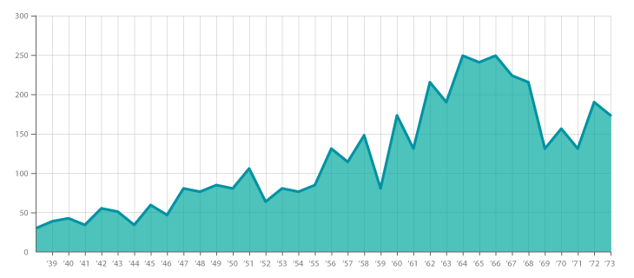
Not about data vis
Terry McCann 2017
Notes:
• How to Use the WHERE Clause
• Overview of Operators
• Filter Data by Using Comparison Operators
• Filter Data by Using String Comparisons
• Filter Data by Using Logical Operators
• Filter Data Using a Range of Values
• Filter Data Using a List of Values
• Working with NULL Values
• Introducing Native SQL Server Functions
• Functions Relating to NULL Values

Slide 8
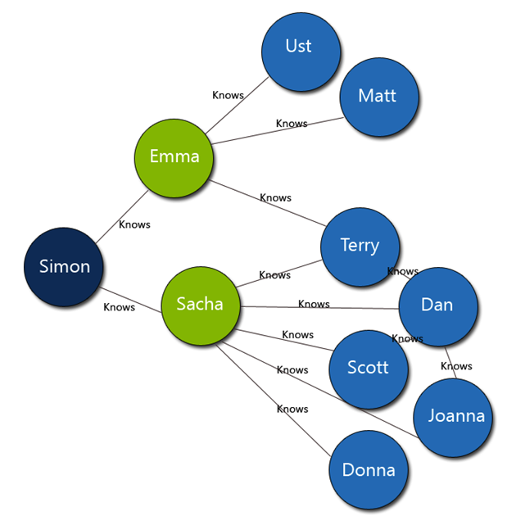
Terry McCann 2017

Slide 9
The History of Graph Databases
Terry McCann 2017

Slide 10
Königsberg Bridge Problem
Terry McCann 2017
Notes:
Let me take you back to the 1700s

Slide 11
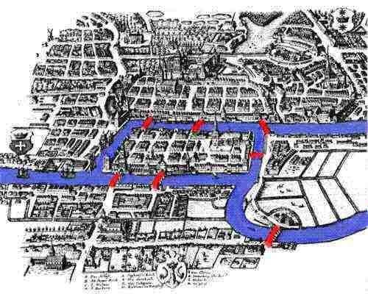

Königsberg Bridge Problem
“Which route would allow you to cross all 7 bridges without crossing any more than once”
Take a minute to work it out
Terry McCann 2017
Notes:
Imagine you’re the mayor of Konigsberg and you are fascinated by your towns 7 bridges, you try to work out if you can cross each bridge only once

Slide 12
Solved it?
Terry McCann 2017

Slide 13
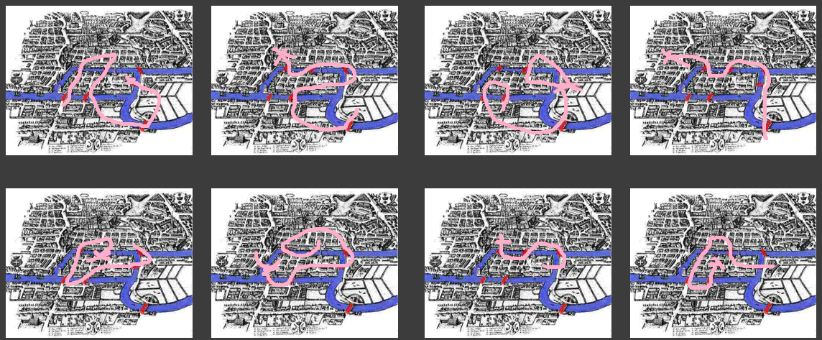
Terry McCann 2017

Slide 14
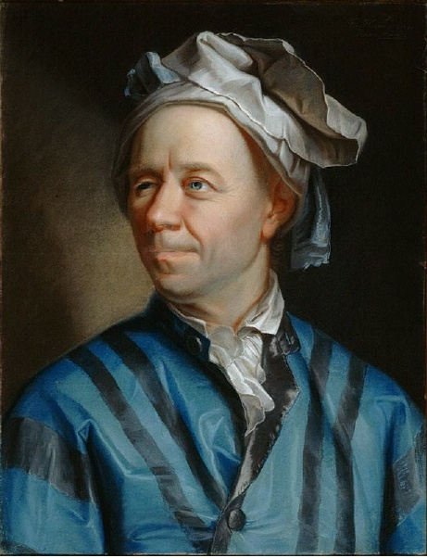
Leonhard Euler
Terry McCann 2017
https://www.youtube.com/watch?v=nZwSo4vfw6c
Notes:
Sent the problem to a man name Oil-ler. Oil-ler was a Swiss mathematician 1707-1783
At first Oil-ler. dismissed the idea as too simple, but when he began to look at the problem in more detail he discovered a new type of geometry.

Slide 15
NORTH BANK
ISLAND ONE
ISLAND TWO
SOUTH BANK
Terry McCann 2017
https://www.youtube.com/watch?v=nZwSo4vfw6c

Slide 16
3
NODE
EDGE
EDGE
EDGE
EDGE
NODE
5
3
NODE
EDGE
EDGE
EDGE
3
NODE
Terry McCann 2017
https://www.youtube.com/watch?v=nZwSo4vfw6c
Notes:
Edge = Bridge
Degrees of each node = numbers
How do we solve the problem? Remove a bridge

Slide 17
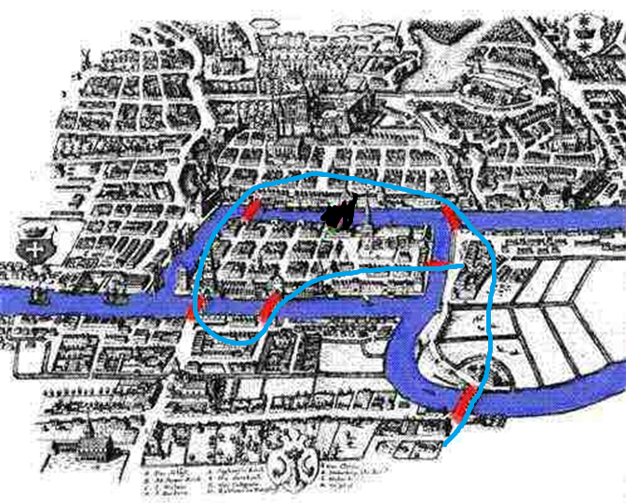
2
NODE
EDGE
EDGE
EDGE
NODE
4
3
NODE
EDGE
EDGE
EDGE
3
NODE
Terry McCann 2017
https://www.youtube.com/watch?v=nZwSo4vfw6c
Notes:
2 nodes of odd degree = a Earlean path

Slide 18
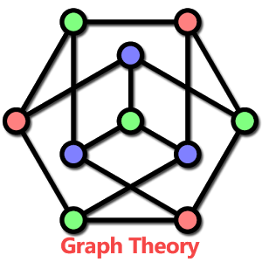
Leonhard Euler
Terry McCann 2017
https://www.youtube.com/watch?v=nZwSo4vfw6c
Notes:
Sent the problem to a man name Oil-ler.
At first Euler dismissed the idea as too simple, but when he began to look at the problem in more detail he discovered a new type of geometry.

Slide 19
EDGE
NODE
NODE
NODE – An entity in a graph
EDGE – Relationship between NODEs
Terry McCann 2017

Slide 20
What is a Graph Database?
Terry McCann 2017

Slide 21
In computing, a graph database is a database that uses graph structures for semantic queries with nodes, edges and properties to represent and store data.
Graph databases, by design, allow simple and fast retrieval of complex hierarchical structures that are difficult to model in relational systems
Terry McCann 2017

Slide 22
You cannot do that in a Relational Database
Terry McCann 2017
Notes:
The worst thing you can do in a session about graph databases is to say, “You cannot do that in a relational database”
As you will all end up looking like this

Slide 23

Terry McCann 2017
Notes:
And not listening to what I am saying.

Slide 24
The problem with relational databases
Terry McCann 2017
Notes:
• How to Use the WHERE Clause
• Overview of Operators
• Filter Data by Using Comparison Operators
• Filter Data by Using String Comparisons
• Filter Data by Using Logical Operators
• Filter Data Using a Range of Values
• Filter Data Using a List of Values
• Working with NULL Values
• Introducing Native SQL Server Functions
• Functions Relating to NULL Values

Slide 25
Why
database?
relational
theory
Terry McCann 2017
Notes:
• How to Use the WHERE Clause
• Overview of Operators
• Filter Data by Using Comparison Operators
• Filter Data by Using String Comparisons
• Filter Data by Using Logical Operators
• Filter Data Using a Range of Values
• Filter Data Using a List of Values
• Working with NULL Values
• Introducing Native SQL Server Functions
• Functions Relating to NULL Values

Slide 26
A Simple Example
Terry McCann 2017
Notes:
I am a website like IMDB.
I want to store Movies and People. A person could be an Actor or a Director and could be both.

Slide 27
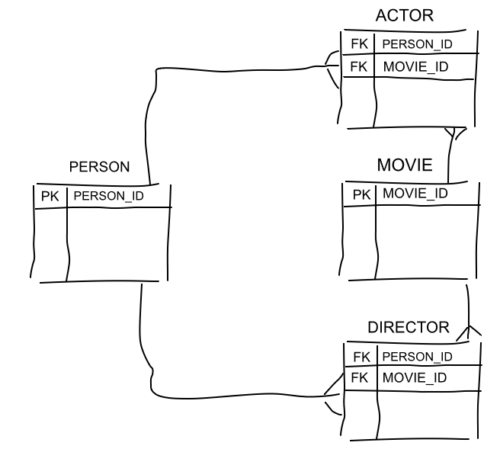
Terry McCann 2017
https://sonra.io/2017/06/12/benefits-graph-databases-data-warehousing/
Notes:
As database developers we instinctively go to this design. The “Relation for Relationship” pattern.
Multiple Many-to-many relationships
Tried ands tested pattern, it works (pause) for storage.
What happens when we need to add a Producer, Financer. We need to add more many-to-many rerlationships.

Slide 28
Impedance Mismatch
Terry McCann 2017
Notes:
• How to Use the WHERE Clause
• Overview of Operators
• Filter Data by Using Comparison Operators
• Filter Data by Using String Comparisons
• Filter Data by Using Logical Operators
• Filter Data Using a Range of Values
• Filter Data Using a List of Values
• Working with NULL Values
• Introducing Native SQL Server Functions
• Functions Relating to NULL Values

Slide 29
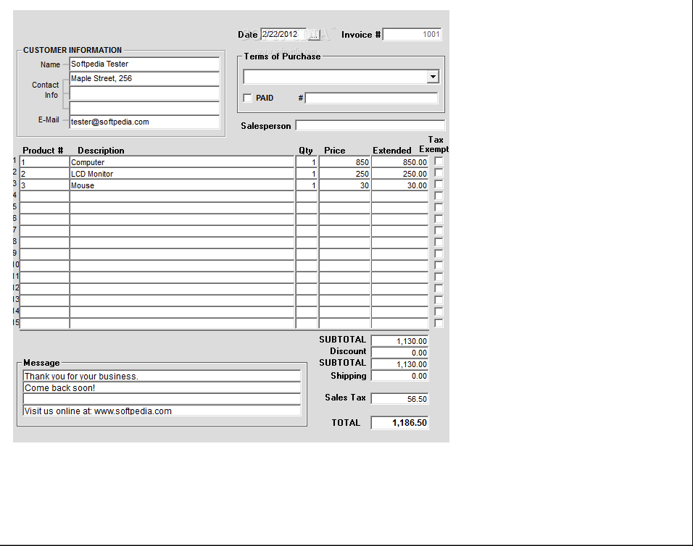
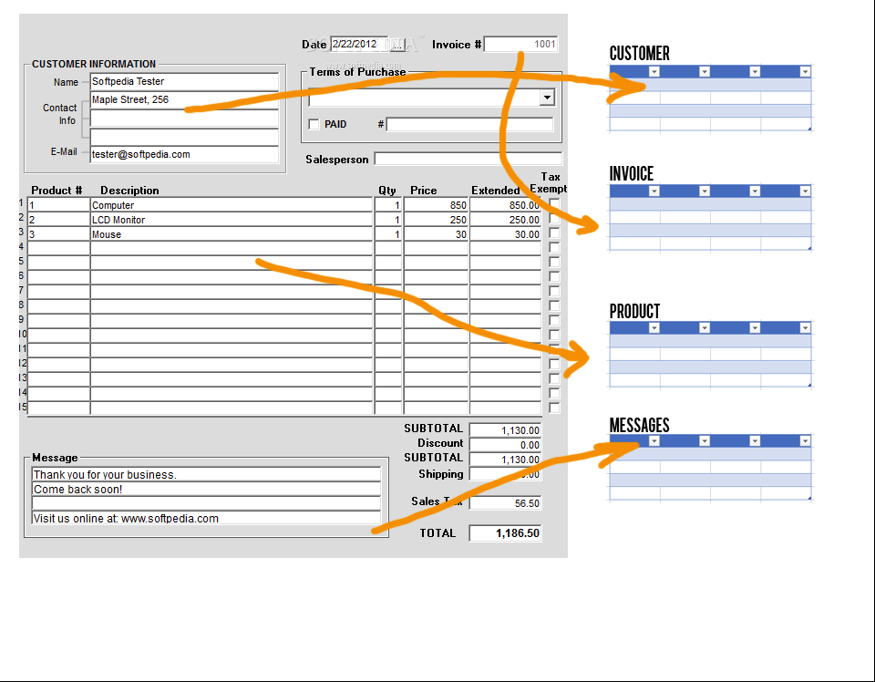
Terry McCann 2017
Notes:
• How to Use the WHERE Clause
• Overview of Operators
• Filter Data by Using Comparison Operators
• Filter Data by Using String Comparisons
• Filter Data by Using Logical Operators
• Filter Data Using a Range of Values
• Filter Data Using a List of Values
• Working with NULL Values
• Introducing Native SQL Server Functions
• Functions Relating to NULL Values

Slide 30
Complex to model and store relationships
Performance degrades with more data
Queries can be long and complex
Terry McCann 2017
Notes:
Yes we can scale, vertically and horizontally, we can index. But as volume increases performance generally decreases.
Queries can be long and complex.

Slide 31
What is complexity in a database?
Terry McCann 2017
Notes:
• How to Use the WHERE Clause
• Overview of Operators
• Filter Data by Using Comparison Operators
• Filter Data by Using String Comparisons
• Filter Data by Using Logical Operators
• Filter Data Using a Range of Values
• Filter Data Using a List of Values
• Working with NULL Values
• Introducing Native SQL Server Functions
• Functions Relating to NULL Values

Slide 32
Complexity=
size
variable structure
connectedness
f( , , )
Terry McCann 2017
Notes:
• How to Use the WHERE Clause
• Overview of Operators
• Filter Data by Using Comparison Operators
• Filter Data by Using String Comparisons
• Filter Data by Using Logical Operators
• Filter Data Using a Range of Values
• Filter Data Using a List of Values
• Working with NULL Values
• Introducing Native SQL Server Functions
• Functions Relating to NULL Values

Slide 33
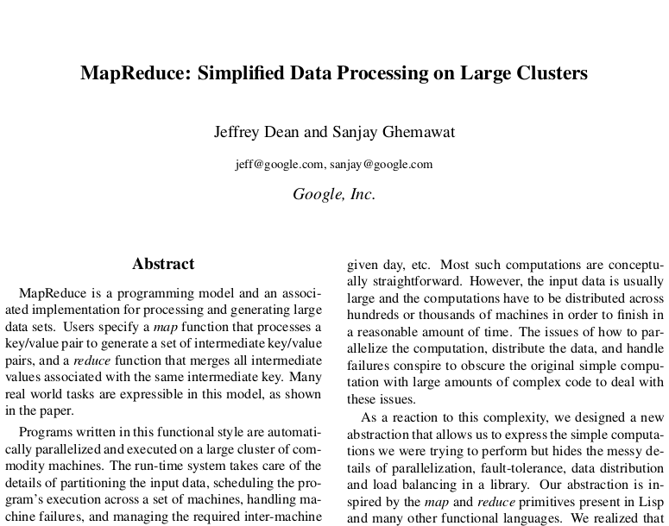
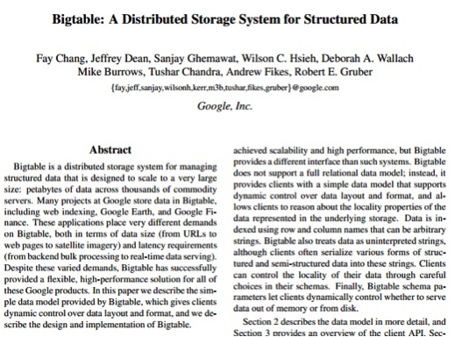
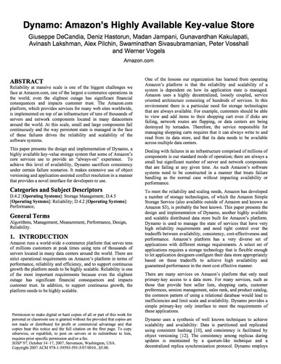
Terry McCann 2017
Notes:
MR – 2004
BT – 2006
D - 2007

Slide 34
Polyglot Persistence
Terry McCann 2017
Notes:
• How to Use the WHERE Clause
• Overview of Operators
• Filter Data by Using Comparison Operators
• Filter Data by Using String Comparisons
• Filter Data by Using Logical Operators
• Filter Data Using a Range of Values
• Filter Data Using a List of Values
• Working with NULL Values
• Introducing Native SQL Server Functions
• Functions Relating to NULL Values

Slide 35
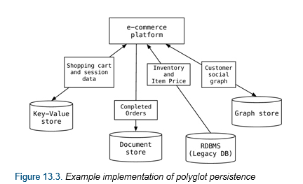
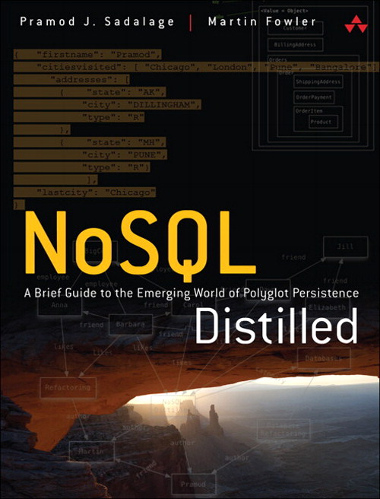

Martin Fowler
Terry McCann 2017

Slide 36
Relational is fantastic but Polyglot Persistence tells us to use the right data store for the challenge we are facing!
If we have highly connected data, a RDBMS might not be the best too for the job!
Terry McCann 2017
Notes:
So if a relational database is not the right storage for our highly connected data, then what is?

Slide 37
A Property Graph
Terry McCann 2017
Notes:
There are a few different types of Graph database. What we have in SQL 2017 CTP2 & RC1 is a Property graph

Slide 38
NODE
NODE
EDGE
Terry McCann 2017
Notes:
There is one important addition here.
The direction of the EDGE.

Slide 39
Person
Movie
Acted In
Terry McCann 2017

Slide 40
Robin Williams
Jumanji
Acted In
Terry McCann 2017

Slide 41
Person
Movie
Directed
Terry McCann 2017

Slide 42
James Cameron
Titanic
Directed
Terry McCann 2017

Slide 43
Entities become NODES
FK/PK relationships become EDGES
Many-To-Many relationships become EDGES
Attributed joins become EDGEs with properties
Terry McCann 2017
Notes:
When translating a relational database structure in to a graph there a few steps we can apply.
What do I mean by an edge with a property?

Slide 44
EDGE properties
Terry McCann 2017
Notes:
Properties on and edge represent the strength or quality of a relationship

Slide 45
User
Movie
Rated
Terry McCann 2017

Slide 46
Ash
Alien
Rated Score:9
Terry McCann 2017

Slide 47
Many-To-Many
PERSON:
Ben Afleck
MOVIE:
Argo
Acted in
Directed by
Acted in
MOVIE:
Batman Vs Superman
Many-To-Many
Terry McCann 2017
https://sonra.io/2017/06/12/benefits-graph-databases-data-warehousing/

Slide 48
Entities become NODES
FK/PK relationships become EDGES
Many-To-Many relationships become EDGES
Attributed joins become EDGEs with properties
Terry McCann 2017
Notes:
When translating a relational database structure in to a graph there a few steps we can apply.
What do I mean by an edge with a property?

Slide 49
Shortest path – What is the shortest path between 2 NODES
Transitive closure – Find a NODE n hops away – Find the NODE which is 10 hops away from where I am now
Polymorphism – Find any NODE connected to another NODE
Terry McCann 2017
Notes:
Use Cases
Transitive closure of a graph
Given a directed graph, find out if a node j is reachable from another node i for all vertex pairs (i, j) in the given graph. Here reachable mean that there is a path from node i to j.
The reach-ability matrix is called transitive closure of a graph.

Slide 50
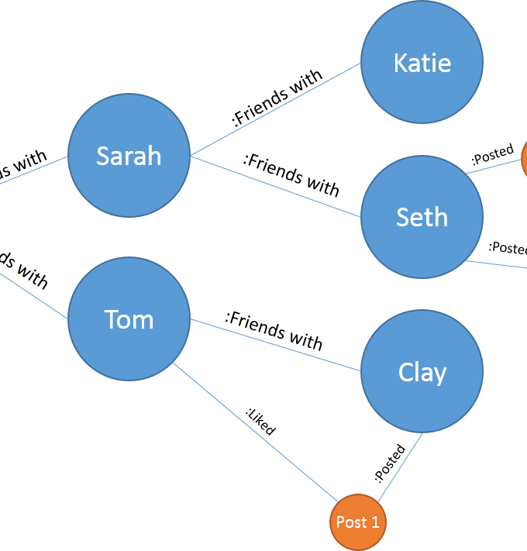
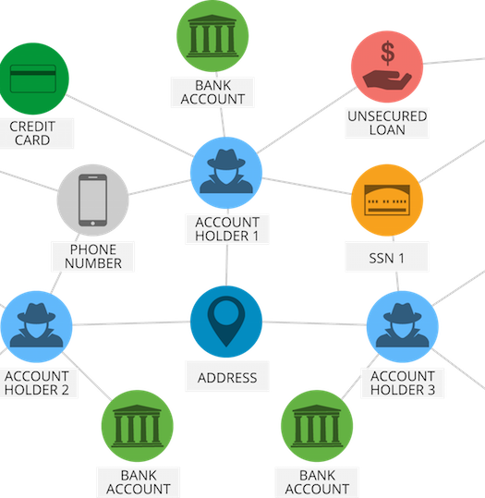
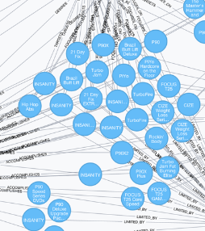
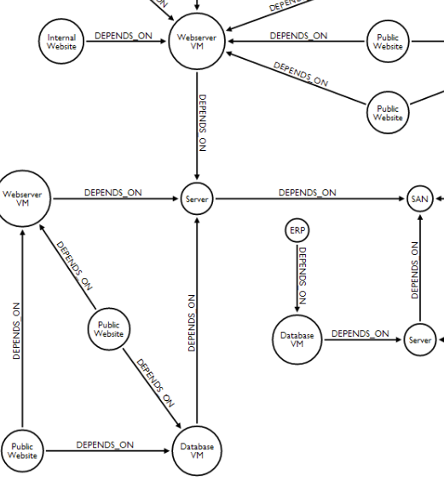
Social Graph
Who knows who? Spot queen bees
Fraud Detection
Spot rings of fraudulent activity
Recommendation
Bob bought X so did Jim, maybe Jim would also like…
Network & IT
Understand the interconnectivity of your network
Terry McCann 2017

Slide 51
How does this relate to SQL Server?
Terry McCann 2017
Notes:
• How to Use the WHERE Clause
• Overview of Operators
• Filter Data by Using Comparison Operators
• Filter Data by Using String Comparisons
• Filter Data by Using Logical Operators
• Filter Data Using a Range of Values
• Filter Data Using a List of Values
• Working with NULL Values
• Introducing Native SQL Server Functions
• Functions Relating to NULL Values

Slide 52
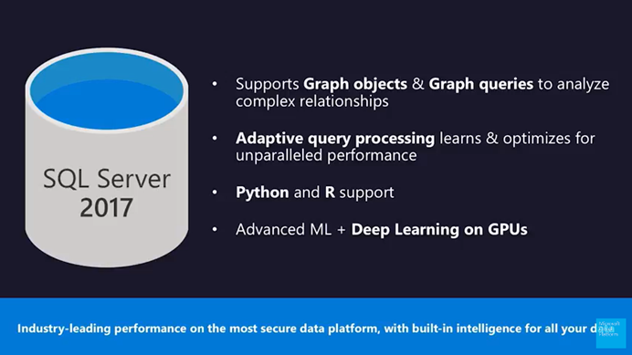
Terry McCann 2017
Notes:
Integrated in SQL Engine
Graphs can be combined with “normal” tables
ColumnStore, Machine Learning, HA, …
Existing Tooling & Eco-System
One Graph per database
Define & create graphs
Via nodes-tables & edge-tables
Query Language Extension
MATCH

Slide 53
NODE aka vertexes
DROP TABLE IF EXISTS Genre;
CREATE TABLE Genre (GenreId INTEGER PRIMARY KEY, Genre VARCHAR(100)) AS NODE;
A node table represents an entity in a graph schema. Every time a node table is created, along with the user defined columns, an implicit $node_id column is created, which uniquely identifies a given node in the database.
$node_id - It is recommended that users create a unique constraint or index on the $node_id column at the time of creation of node table, but if one is not created, a default unique, non-clustered index is automatically created.
Terry McCann 2017
https://docs.microsoft.com/en-us/sql/relational-databases/graphs/sql-graph-architecture

Slide 54
EDGE aka relationship
DROP TABLE IF EXISTS ActedIn;
CREATE TABLE ActedIn AS EDGE;
An edge table represents a relationship in a graph. Edges are always directed and connect two nodes. An edge table enables users to model many-to-many relationships in the graph.
Each edge table has three pseudo-columns:
$edge_id: The id of the edge record
$from_id: One of the nodes in the edge record
$to_id: The other node in the edge record
Terry McCann 2017

Slide 55
MATCH
SELECT
M.Movie
, U1.FullName
, U2.FullName
FROM dbo.[USER] U1, dbo.[USER] U2, dbo.Movie M, dbo.Reviewed R1, dbo.Reviewed R2
WHERE MATCH (U1-(R1)->M<-(R2)-U2)
Specifies a search condition for a graph. MATCH can be used only with graph node and edge tables, in the SELECT statement as part of WHERE clause.
ASCII ART Syntax based on Cypher
Node-(edge)->Node OR Node<-(edge)-Node
Terry McCann 2017

Slide 56
Demo
Terry McCann 2017

Slide 57
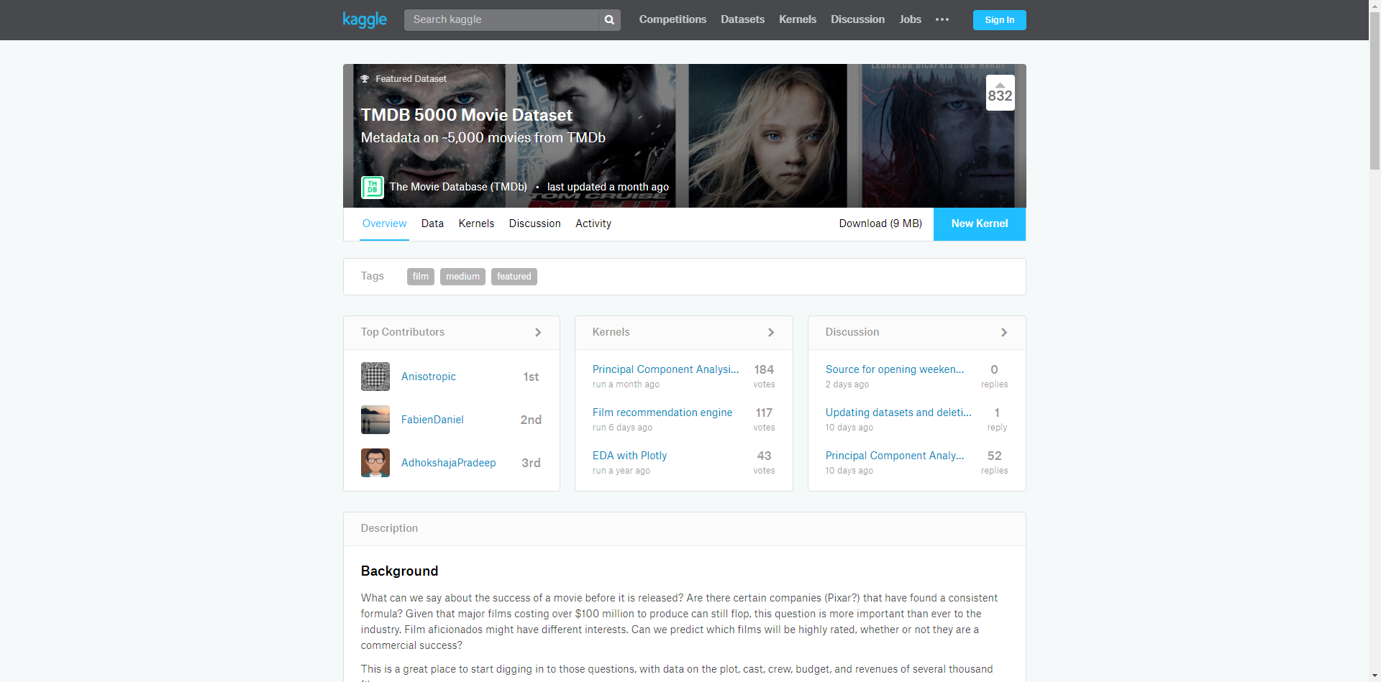
Demo
Terry McCann 2017
https://www.kaggle.com/tmdb/tmdb-movie-metadata

Slide 58
Demo
Terry McCann 2017

Slide 59
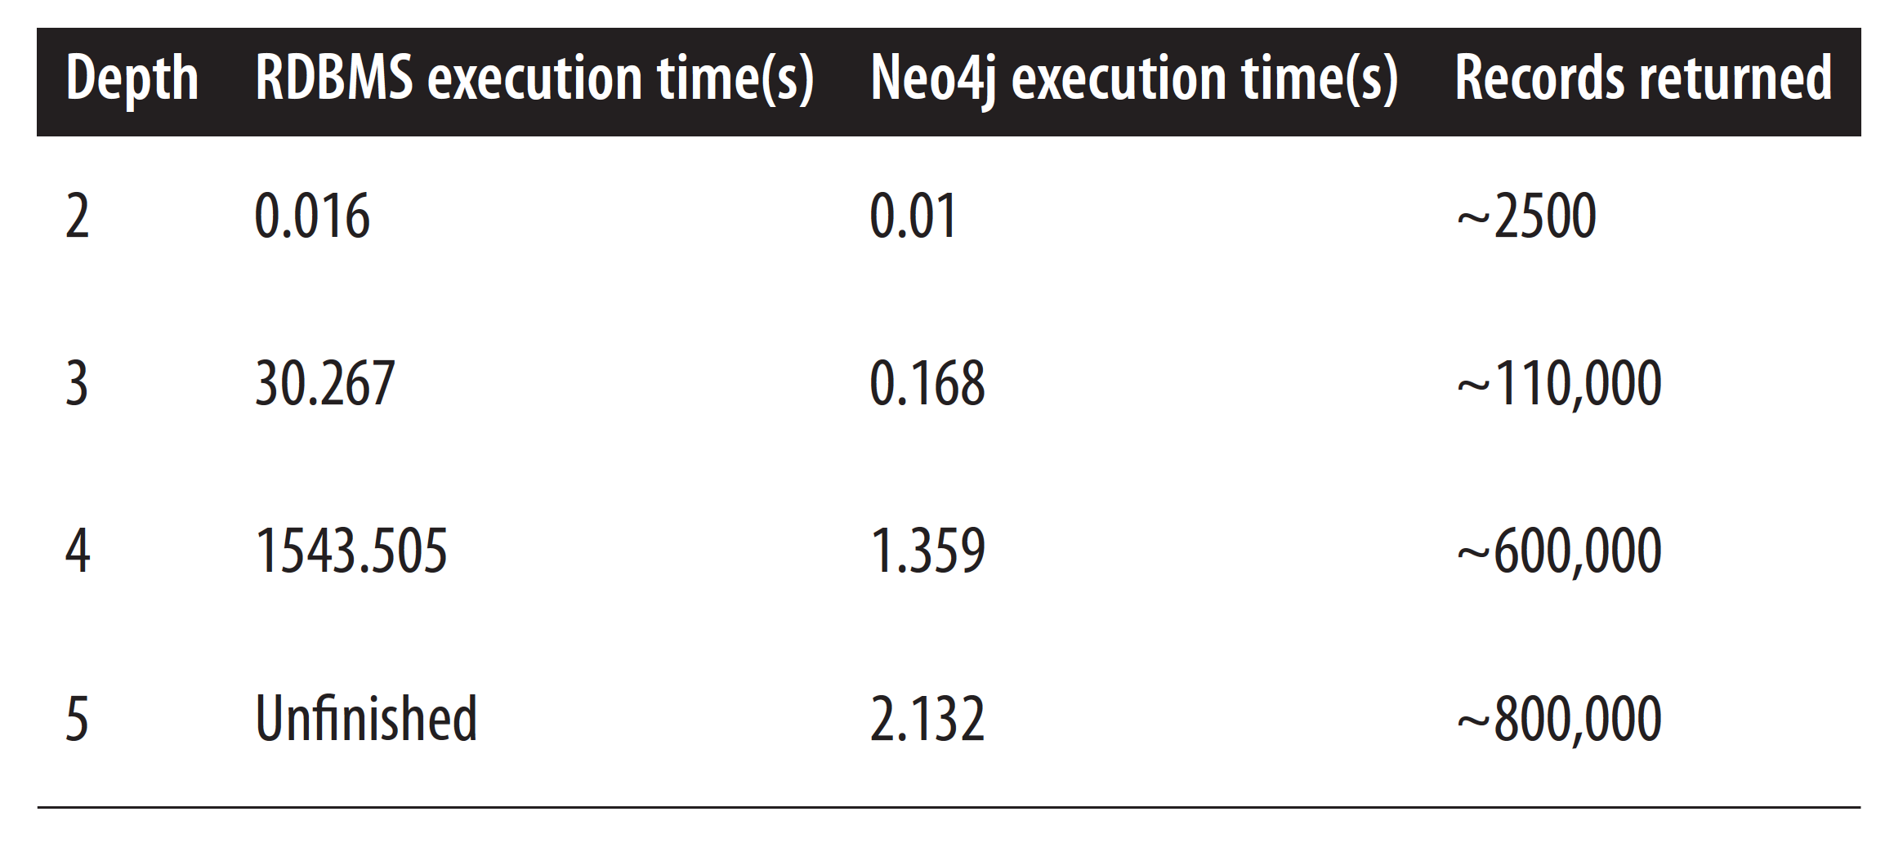
Terry McCann 2017
Notes:
https://neo4j.com/blog/why-database-query-language-matters/

Slide 60
MATCH caveats
The node names inside MATCH can be repeated. In other words, a node can be traversed an arbitrary number of times in the same query.
An edge name cannot be repeated inside MATCH.
An edge can point in either direction, but it must have an explicit direction.
OR and NOT operators are not supported in the MATCH pattern. MATCH can be combined with other expressions using AND in the WHERE clause. However, combining it with other expressions using OR or NOT is not supported
Terry McCann 2017

Slide 61
Limitations
Shortest path – What is the shortest path between 2 NODES
Transitive closure – Find a NODE n hops away – Find the NODE which is 10 hops away from where I am now
Polymorphism – Find any NODE connected to another NODE
Terry McCann 2017
Notes:
Use Cases
Transitive closure of a graph
Given a directed graph, find out if a node j is reachable from another node i for all vertex pairs (i, j) in the given graph. Here reachable mean that there is a path from node i to j.
The reach-ability matrix is called transitive closure of a graph.

Slide 62
Limitations continued
Local or global temporary tables cannot be node or edge tables.
Table types and table variables cannot be declared as a node or edge table
Node and edge tables cannot be created as system-versioned temporal tables.
Node and edge tables cannot be memory optimized tables.
Users cannot update the $from_id and $to_id columns of an edge using UPDATE statement. To update the nodes that an edge connects, users will have to insert the new edge pointing to new nodes and delete the previous one.
Cross database queries on graph objects are not supported.
Terry McCann 2017

Slide 63
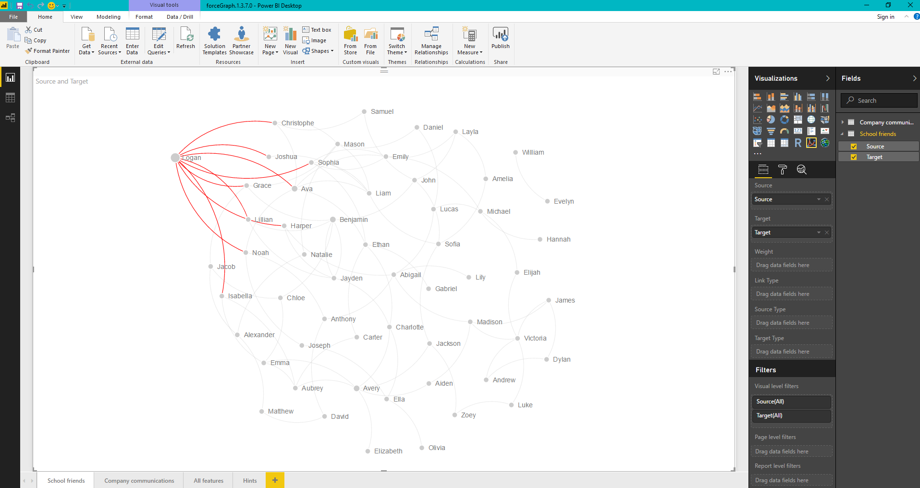
Terry McCann 2017

Slide 64
<Appendix> - Research
https://www.mssqltips.com/sqlservertip/4883/sql-server-2017-graph-database-example/
http://sqlblog.com/blogs/john_paul_cook/archive/2017/06/19/modeling-many-to-many-relationships-in-sql-server-2017-graph-database.aspx
https://stephanefrechette.com/sql-graph-sql-server-2017/#.WVbCP2grKUl
https://blogs.technet.microsoft.com/dataplatforminsider/2017/04/20/graph-data-processing-with-sql-server-2017/
https://stackoverflow.com/questions/20979831/recursive-query-used-for-transitive-closure
https://blogs.msdn.microsoft.com/sqlcat/2017/04/21/build-a-recommendation-system-with-the-support-for-graph-data-in-sql-server-2017-and-azure-sql-db/
https://github.com/arvindshmicrosoft/MillionSongDatasetinSQLServer
https://github.com/Microsoft/sql-server-samples/blob/master/samples/applications/iot-connected-car/README.md
https://www.youtube.com/watch?v=3vleFxDGoEs
https://www.simple-talk.com/sql/t-sql-programming/sql-graph-objects-sql-server-2017-good-bad/
https://sonra.io/2017/06/12/benefits-graph-databases-data-warehousing/
https://social.technet.microsoft.com/wiki/contents/articles/37993.t-sql-graph-based-tables-in-sql-2017.aspx
Terry McCann 2017

Slide 65

Graph processing is amazing!
However, SQL Server is not quite there yet! When Graph Processing in SQL Server can rival Neo4j, we will have a very powerful system.
Thank you
@SQLShark
tpm@adatis.co.uk
www.adatis.co.uk
@AdatisBI

Slide 66
So we have extra time…
Terry McCann 2017

Slide 67
Social Graph
Who knows who? Spot queen bees
Fraud Detection
Spot rings of fraudulent activity
Recommendation
Bob bought X so did Jim, maybe Jim would also like…
Network & IT
Understand the interconnectivity of your network
Terry McCann 2017

Slide 68
NODE
EDGE
EDGE
NODE
NODE
Terry McCann 2017
Notes:
There is one important addition here.
The direction of the EDGE.

Slide 69
Sam
Knows
Knows
Josh
Mark
Triadic Closure
Terry McCann 2017
Notes:
There is one important addition here.
The direction of the EDGE.

Slide 70
Recommendation Demo
Terry McCann 2017

Slide 71
Sam
Josh
Liked (Rated: 10)
Liked
(Rated: 10)
Liked
(Rated: 10)
Movie 1
Movie 2
Terry McCann 2017
Notes:
There is one important addition here.
The direction of the EDGE.

Slide 72
<Title>
Terry McCann 2017

